Slide 1
Python Grain-orientation mapping tool
Kaci Kus

Slide 2
Data Prep: Image sampling
Open data_processing.ipynb
2. Load in original large-scale image
← Change the path to the image if necessary
← Change the path/name of the .npy file it saves as

Slide 3
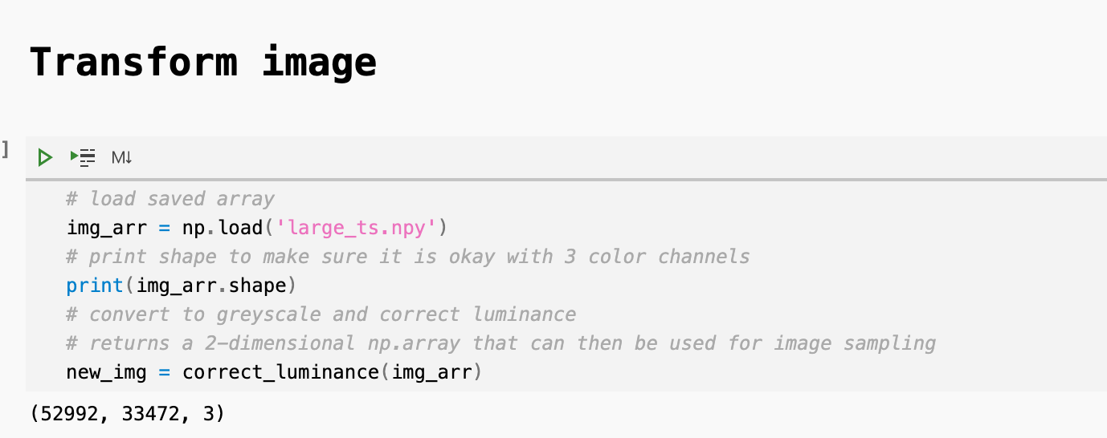
Adjust image
.npy array should be in 3 channel RGB format
← Check that the print statement shows 3 channels

Slide 4
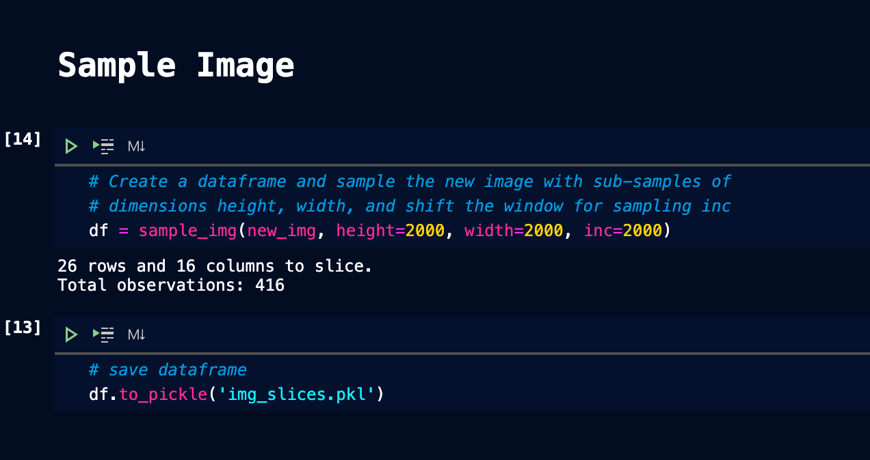
Sub-sample image into smaller sub-images
New_img = 2-D numpy array, greyscale image
Height = height in pixels of sub-image to be sampled
Width = width in pixels of sub-image to be sampled
Inc = increment to shift from one image to the next. If inc == height == width, then there is no overlap in sub-images.
Save sub-images to a pickle

Slide 5
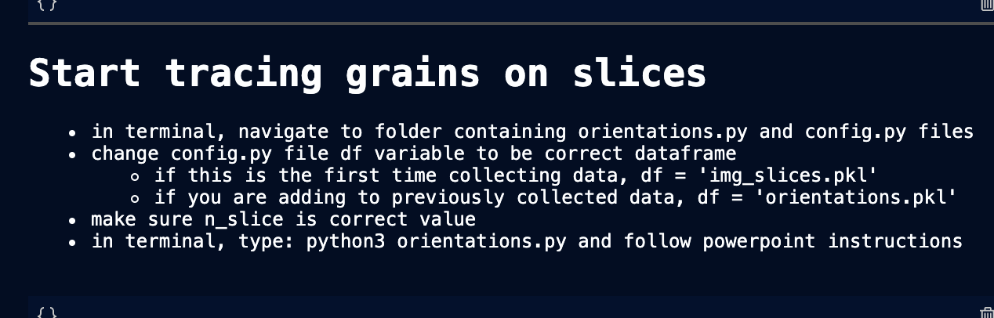
Follow steps:
N_slice begins at 0 for the top left most sub-image, and slices move left to right, top to bottom.
Make sure to set to 0 for your first session.
Make sure that ‘img_slices.pkl’ is the pickle containing the dataframes with the image slices stored
This should be kept in the same folder as orientations.py and config.py

Slide 6
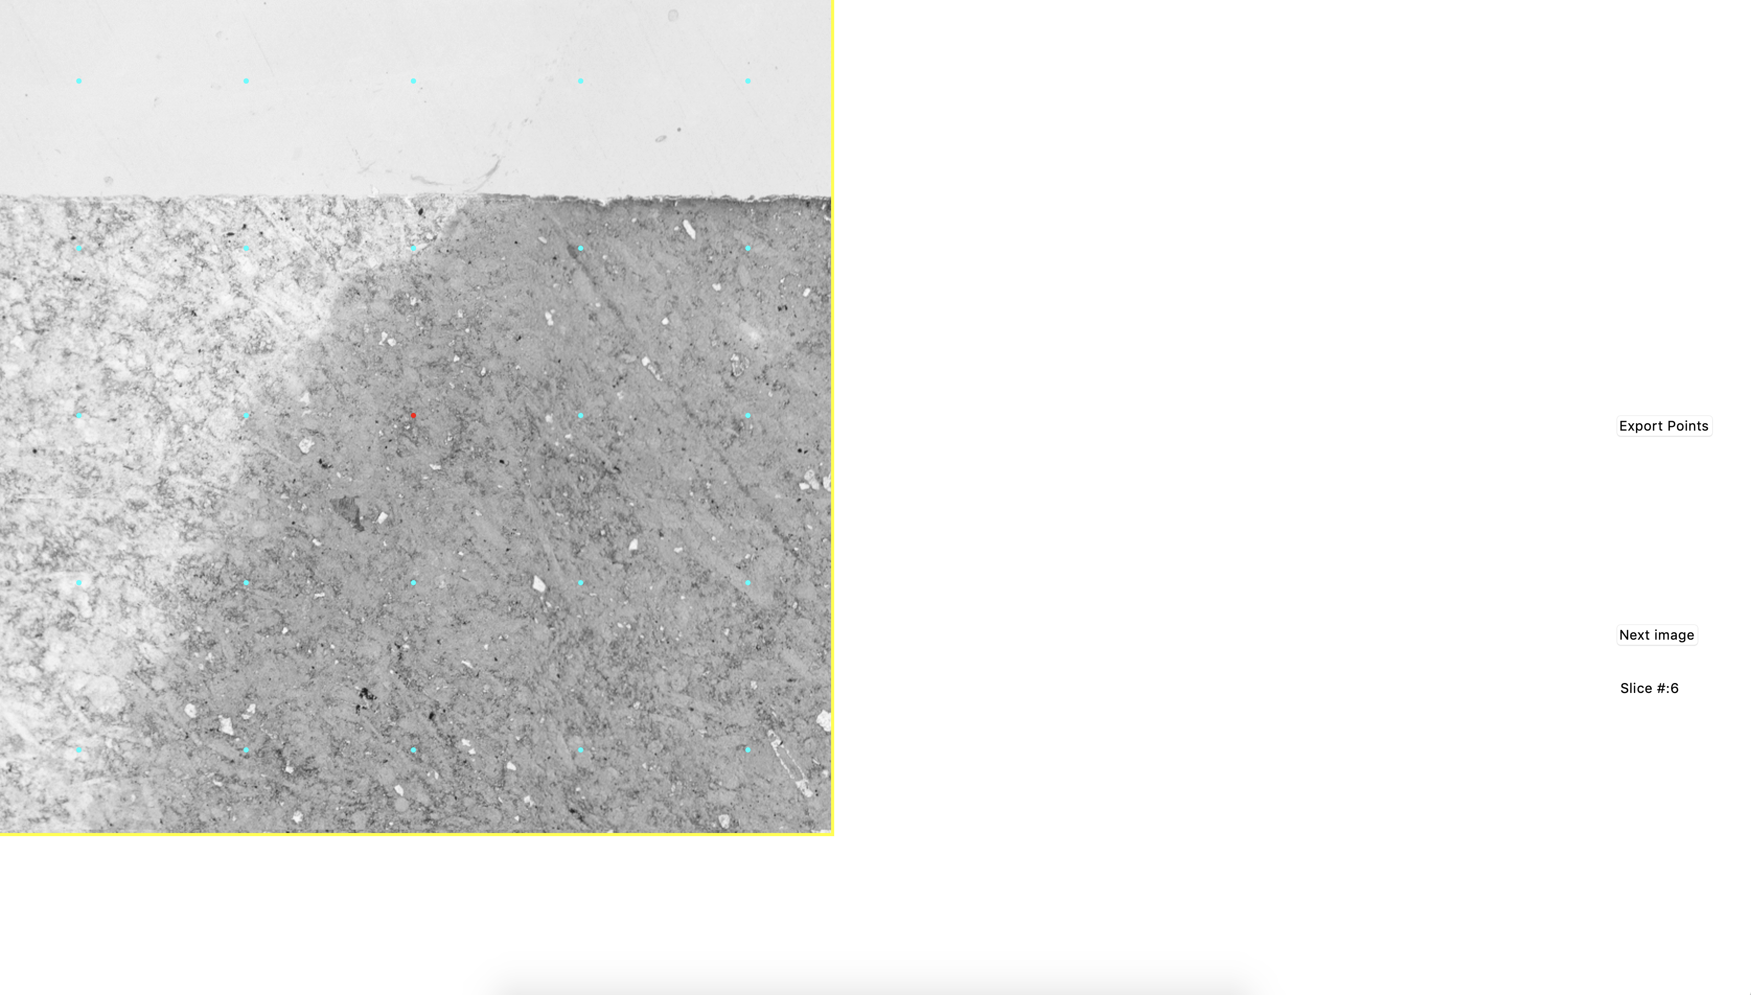
When you run the program:
Save your progress →
Click to go to next image →
Shows the image slice you are on →
If you re-do an image slice, as in you have already done slice 6, but then you
Start up the program at slice 6 again… I believe it should overwrite the previous
Data for that slice, but you should probably confirm yourself

Slide 7
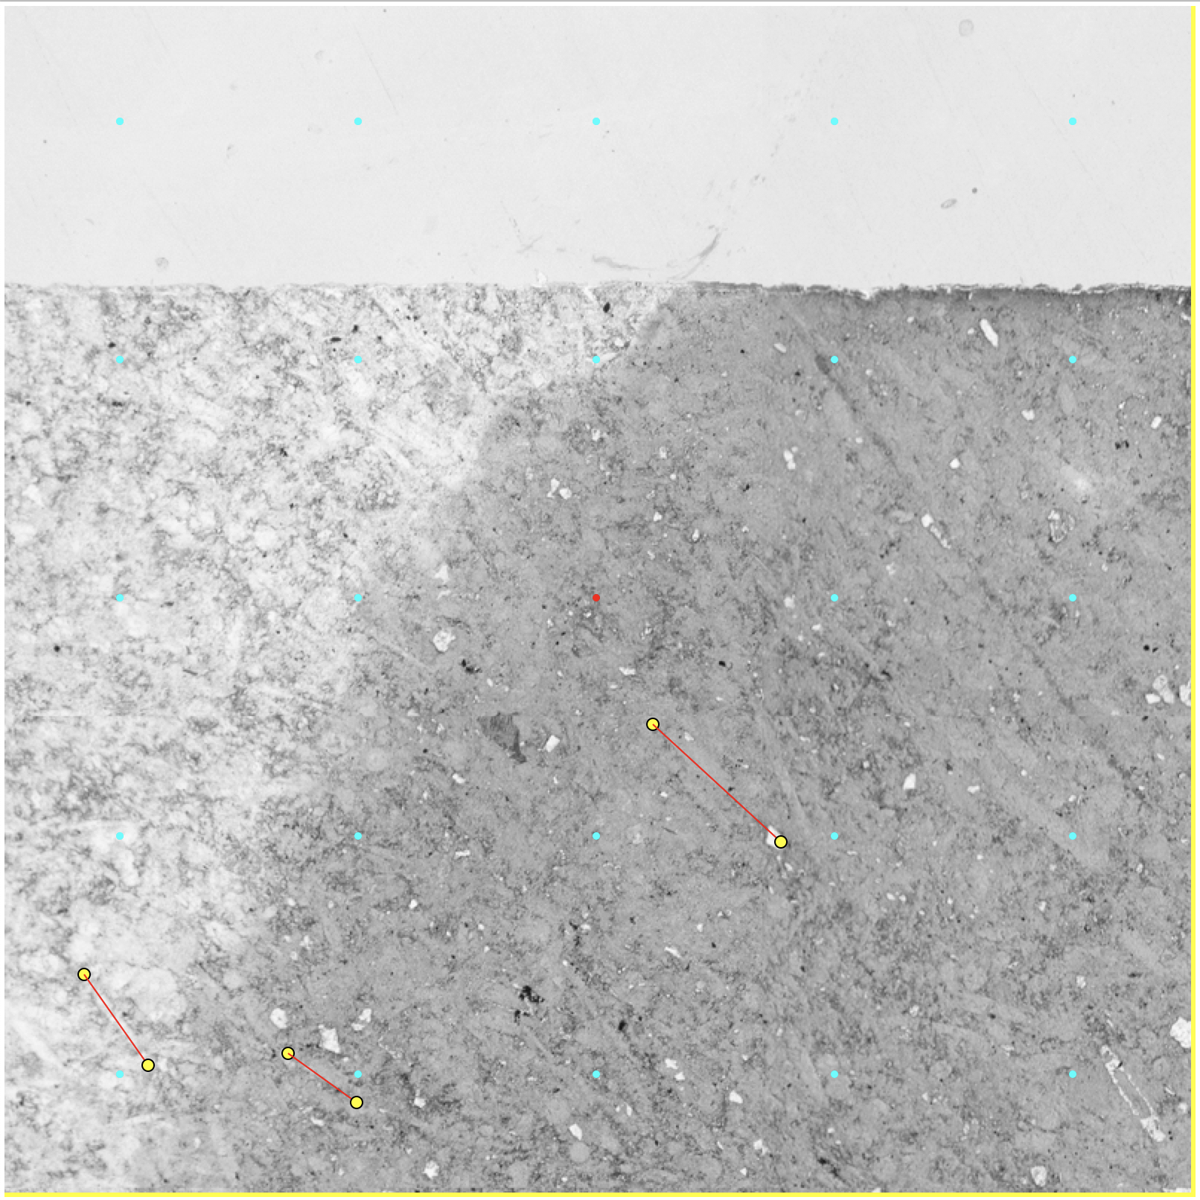
A yellow dot will appear for each click,
And every pair of clicks is lined in red.
Center of sub-image →
Evenly spaced grid, specified in config.py as grid_dims, are marked in cyan

Slide 8
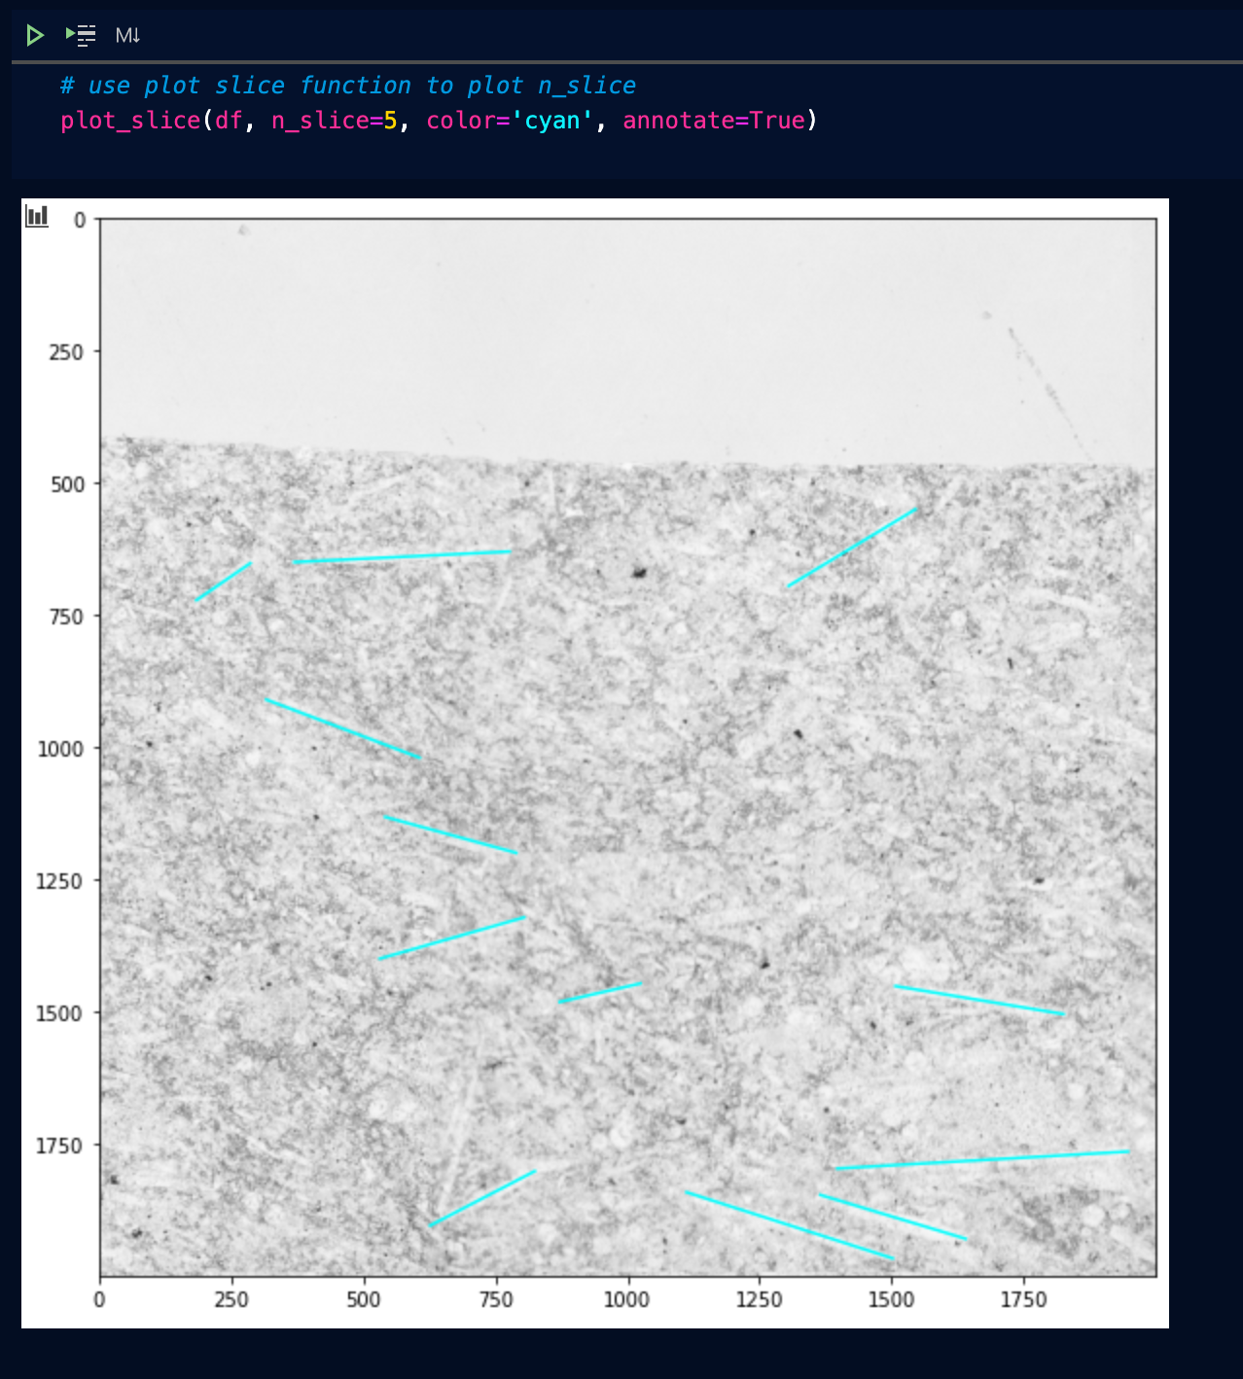
Visually check data
Load the updated dataframe and use the
Plot_slice() function

